Slide 1
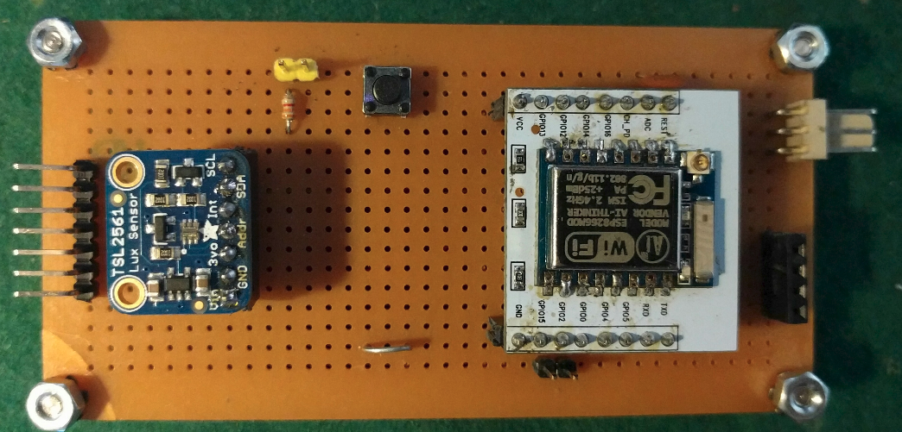
Fotómetro IoT
Rev 2.0
GEDA – Ing. Jacoby

Slide 2
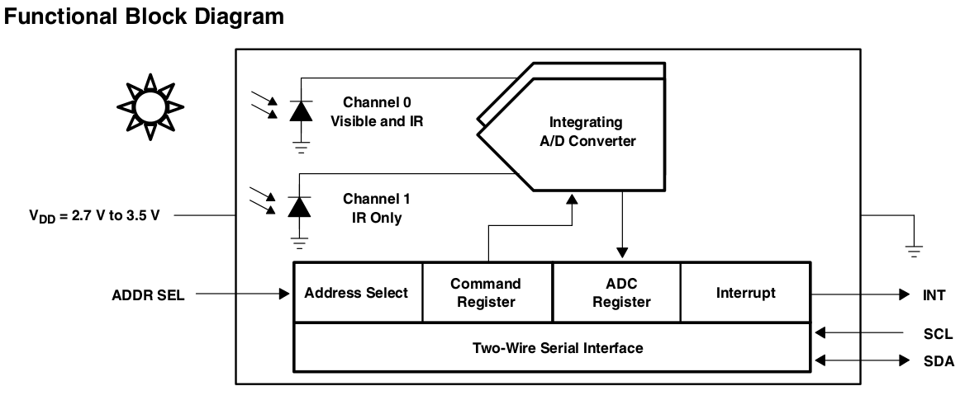
Fotómetro IoT
Basado en el IC TSL2561
GEDA – Ing. Jacoby

Slide 3




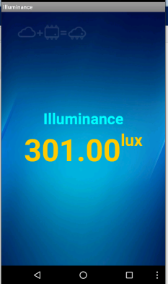




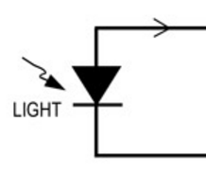
Fotómetro Conectividad
Remote Access
IC2Cloud
Cloud
Fotómetro
RS232
WIFI
GEDA – Ing. Jacoby

Slide 4
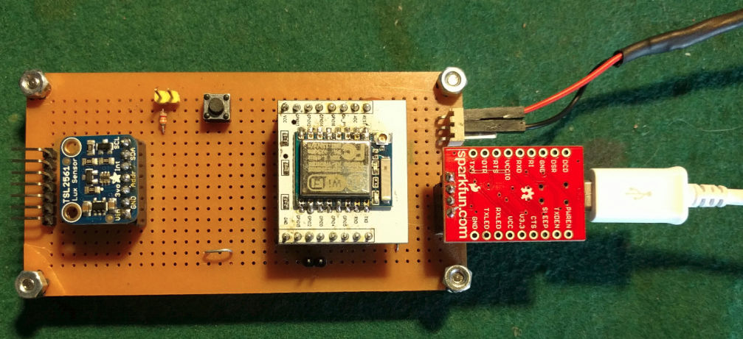
Fotómetro I/O
WiFi-Cloud
Enabled[open]/Disabled[closed]
Reset
5V
Second TLS
OLED Display
Extension
SCL
GND
5V – 1A
SDA
5V
ESP-07
GND
N/C
RS232 3.3V TTL
3V3
RXD
(Baud Rate 115200)
TXD
GND
GND Tip
Run[open]/Pgm[closed]
GEDA – Ing. Jacoby

Slide 5
Photometer operating modes
Cloud mode: when WIFI is available (yellow jumper open at power on)
Standalone mode: when WIFI is not available (yellow jumper closed at power on)
In both cases serial output is available . Output Rate: 1 sample every 2 seconds⁽¹⁾
Cloud mode: Samples are sent to cloud and from cloud to phone apk (illuminance.apk)
WIFI parameters setup
Wireles router / AP / Hotspot Name : IOT_WIFI
Password: GEDA2016
GEDA – Ing. Jacoby

Slide 6
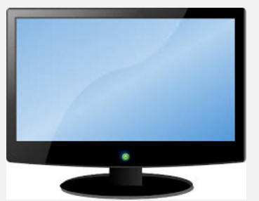
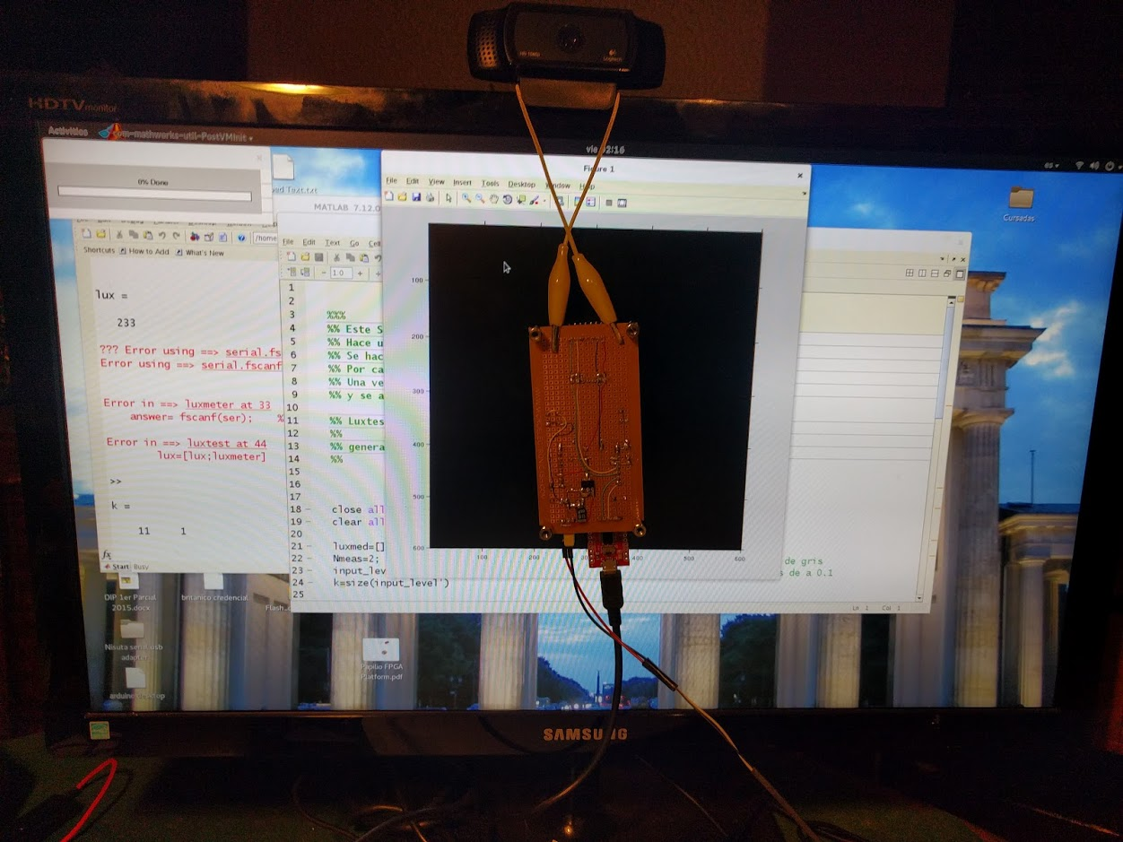
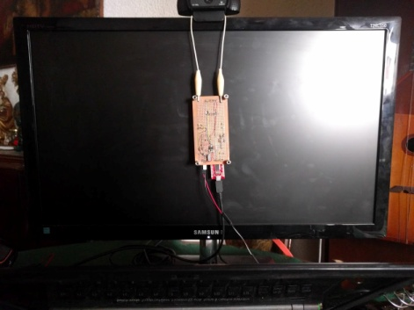
Tests
Automated Gamma Measurement for LCD display using Matlab
Setup
Fotometer
GEDA – Ing. Jacoby

Slide 7
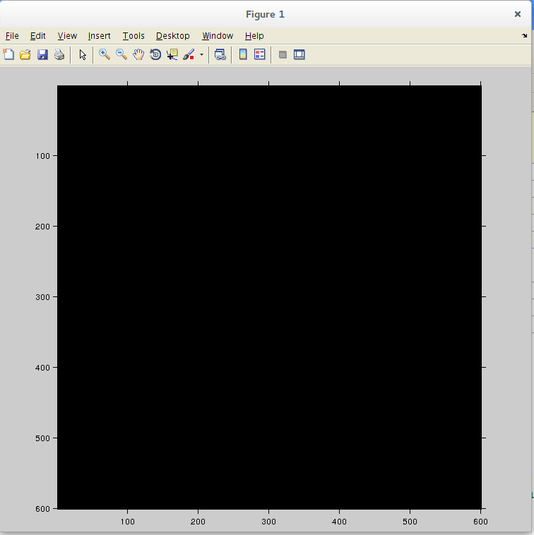
Tests
Automated Gamma Measurement for LCD display using Matlab:
Measurement Loop
Generate 11 Gray Levels
USB Serie
GEDA – Ing. Jacoby

Slide 8
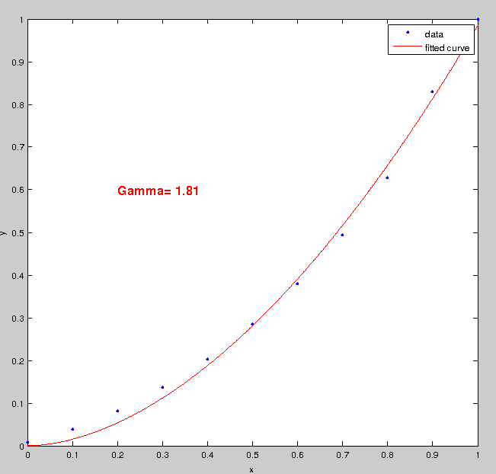
Tests: Samsung T24C550
Automated Gamma Measurement for LCD display using Matlab
Results:
GEDA – Ing. Jacoby

Slide 9
Tests: Samsung T24C550
Automated Gamma Measurement for LCD display using Matlab
Results:
Gamma Control | Measured Gamma
-3 | 1.6
0 | 1.8
+3 | 2.1
GEDA – Ing. Jacoby

Slide 10
Matlab Files
Luxmeter.m : Returns Light Luminosity in lux
Luxtest.m : Photometer Measurement Program
Start
Set Gray Level
Measure
(Luxmeter.m)
Last ?
Adjust acquired data
Using
CFT (Curve fitting Tool)
and find out gamma
Plot Results,
Fitted Curve and Gamma
Next Gray Level
END
GEDA – Ing. Jacoby

Slide 11
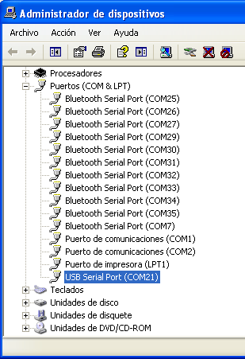
Measurement setup and use
1- Connect the photometer to USB to serial converter
2- Connect the photometer to power supply
3- Connect the USB serial converter cable to computer USB port
Find out the USB serial port on computer (COMxx)
5- Edit and modify serial port on luxmeter.m
ser = serial('COM1'); % Windows port style
ser = serial('/dev/ttyUSB0'); % Linux port style
GEDA – Ing. Jacoby

Slide 12
Measurement setup and use
6- Attach photometer as close a possible to monitor
7- Open matlab and run luxtest.m
Notes: Each sample is taken every 2 seconds (defined on firmware)
Two samples are taken per gray level and averaged
(see Nmeas on luxtest.m)
GEDA – Ing. Jacoby

Slide 13
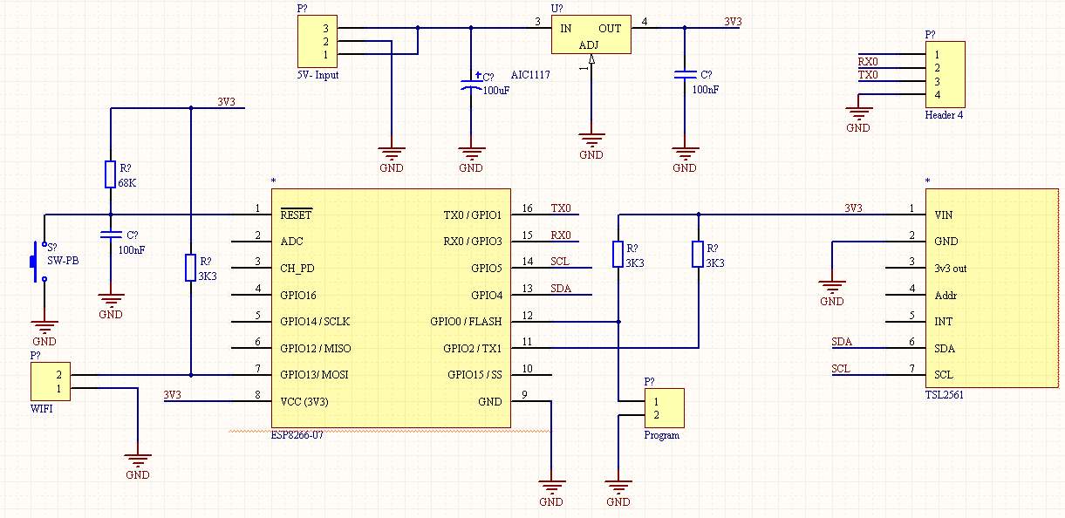
Schematic
GEDA – Ing. Jacoby

Slide 14

APP: Illuminance.apk
http://personal.ik.itba.edu.ar/~jacoby/ilum/
GEDA – Ing. Jacoby

